Slide 1
ARM Based liquid level detection and flow control using tft display
Prepared by
Name : Ankita gupta (23070147001)
Aniketh mehta (23070147002)
Sailesh kumar pasam (23070147005)

Slide 2
Objective
To develop a system that can control the flow of liquid and detect various parameters related to the liquid using ARM controller and display the information on TFT display.
Parameters:
Flow Control
Temperature
Pressure
Turbidity
TDS(Total Dissolved Solids)

Slide 3
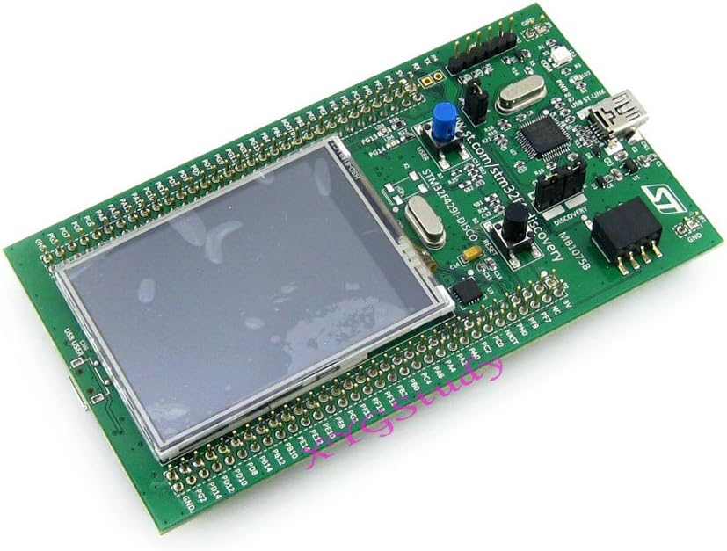
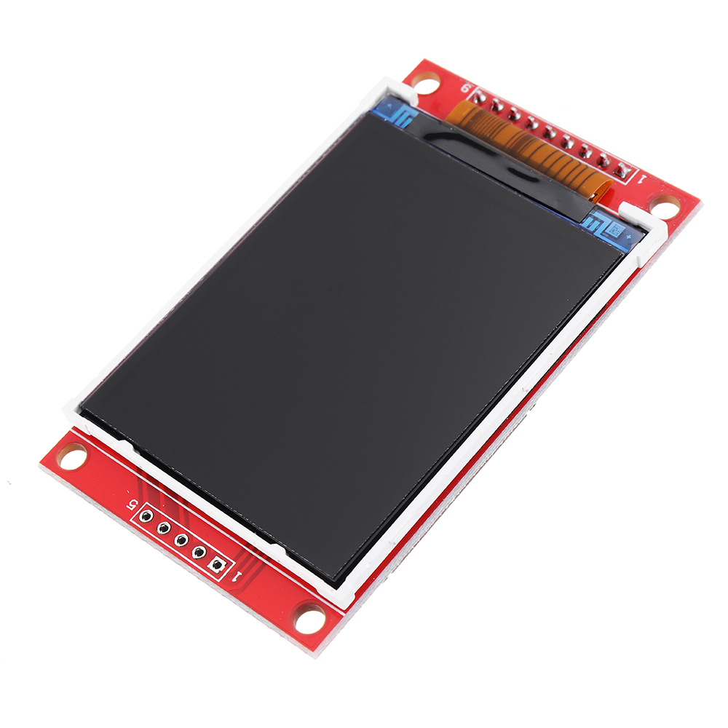
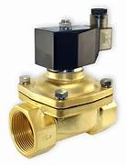
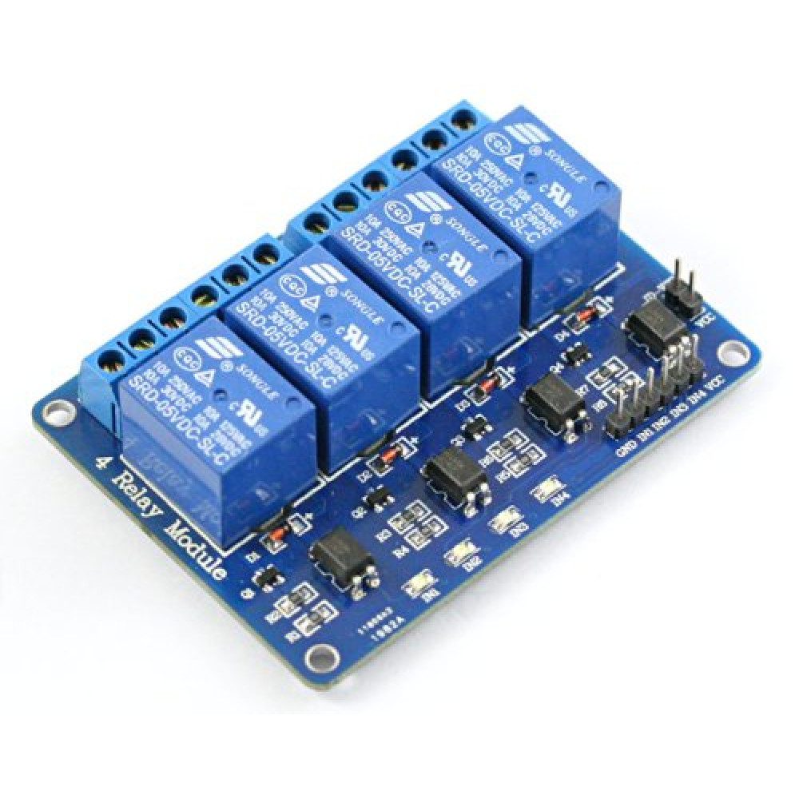
Components
STM32F429ZIT6
TFT Display
Solenoid valve
4 Channel Relay Module

Slide 4
Thank You

